Slide 1
Chapter 17 Interpolation
By
Hyung Jae (Chris) Chang
Troy University

Slide 2
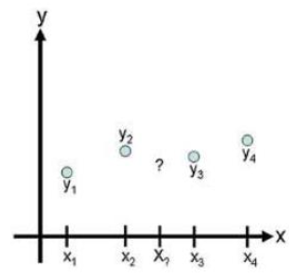

Introduction
A dataset consisting of independent data values, x_{i} and dependent data values, y_{i} where i = 1, 2, …, n
Goal: find an estimation function $\hat{y}$ such that $\hat{y}\left(x_{i}\right)=y_{i}$ for every point in our dataset.
Given a new x*, we can interpolate its function value using $\hat{y}(x^{∗})$ which is called interpolation function.
Illustration of the interpolation problem: estimate the value of a function in-between data points.

Slide 3

Linear Interpolation
In linear interpolation, the estimated point is assumed to lie on the line joining the nearest points to the left and right.
Given x-data points in ascending order (x_{i} < x_{i+1}) and x being a point such that x_{i} < x < x_{i+1}, the linear interpolation at x is

Slide 4
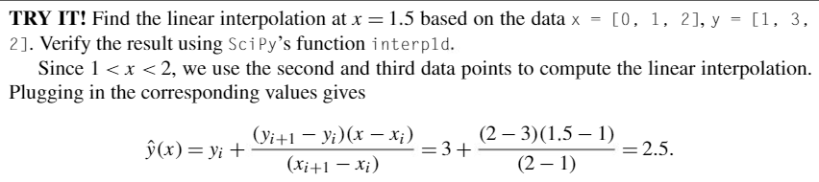
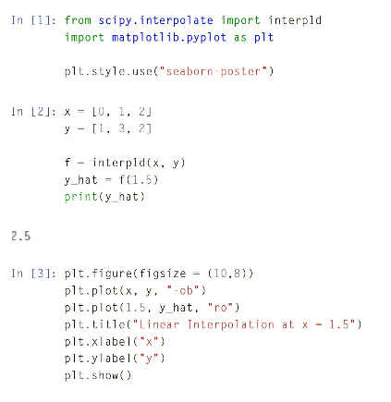
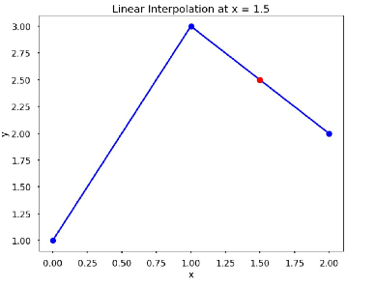
Example

Slide 5

Cubic Spline Interpolation
In cubic spline interpolation, the interpolation function is a set of piecewise cubic functions with an assumption that the points (x_{i}, y_{i}) and (x_{i+1}, y_{i+1}) are joined by a cubic polynomial S_{i}(x).
$S_{i}\left(x\right)= a_{i}x^{3}+b_{i}x^{2}$+ $c_{i}x$+ $d_{i}$
which is valid for x_{i} <=x <= x_{i+1} for i = 1, 2, …, n-1
To find the interpolation function, we need to first find coefficients $a_{i}$ $b_{i}$ $c_{i}$ $d_{i}$ for each of the cubic functions
For n points, there are n-1 cubic functions to find total 4(n-1) coefficient
Need 4(n-1) independent equations to find all the coefficients!

Slide 6

Cubic Spline Interpolation
$S_{i}\left(x_{i}\right)=y_{i}$
$S_{i}\left(x_{i+1}\right)=y_{i+1}$
Cubic functions must intersect data points on the left and the right
Which gives us 2(n-1) equations
$S_{i}^{′}\left(x_{i+1}\right)=S_{i+1}^{′}\left(x_{i+1}\right)$
$S_{i}^{′′}\left(x_{i+1}\right)=S_{i+1}^{′′}\left(x_{i+1}\right)$
Cubic function to join as smoothly with its neighbors as possible →constrain the splines to have continuous first and second derivatives at data points i = 2, …, n-1
Which gives us 2(n-2) equations
$S_{1}^{′′}\left(x_{1}\right)=0$
$S_{n−1}^{′′}\left(x_{n}\right)=0$
Arbitrary. Chosen to fit the circumstances of the interpolation.
A common set of final constraints is to assume that the second derivatives are 0 at endpoints → the curve is a straight line at end points.

Slide 7
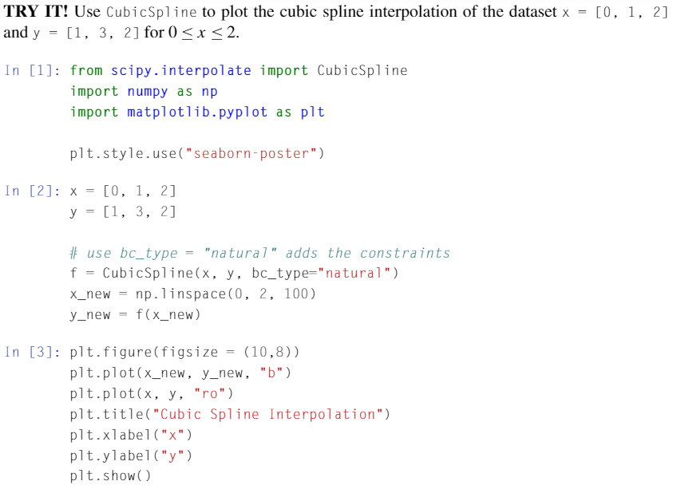
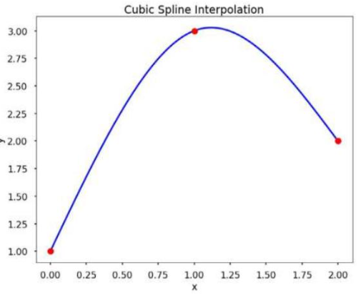
Cubic Spline Interpolation in Python
Use SciPy’s function, CubicSpline.

Slide 8
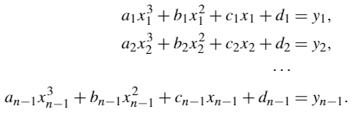
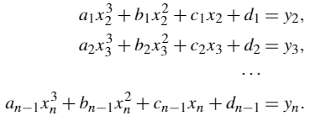
Finding Coefficients
Uses system of linear equations with 4(n-1) unknowns for the constraints.
For n data points, the unknows are the coefficients a_{i}, b_{i}, c_{i}, d_{i} of the cubic spline, S_{i}, joining the points x_{i} and x_{i+1}.
Constraints: S_{i}(x_{i}) = y_{i}
Constraints: S_{i}(x_{i+1}) = y_{i+1}

Slide 9
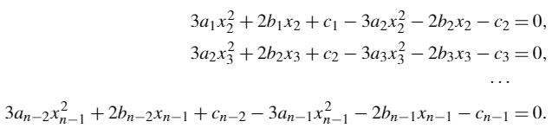
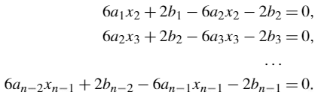

Finding Coefficients (cont.)
Constraints: S_{i}’(x_{i+1}) = S_{i+1}’(x_{i+1})
Constraints: S_{i}’’(x_{i+1}) = S_{i+1}’’(x_{i+1})
End point constraints: S_{i}’’(x₁) = 0 and S_{n-1}’’(x_{n}) = 0.

Slide 10
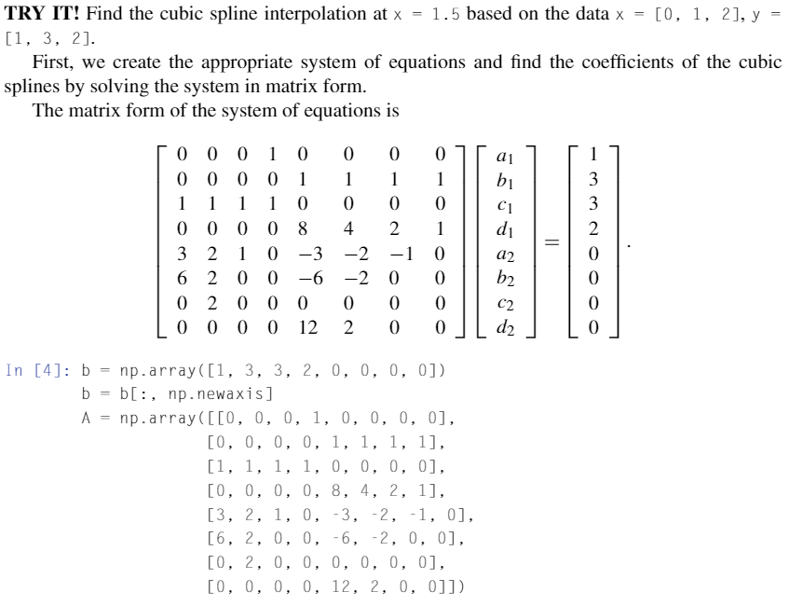
Example in Python

Slide 11
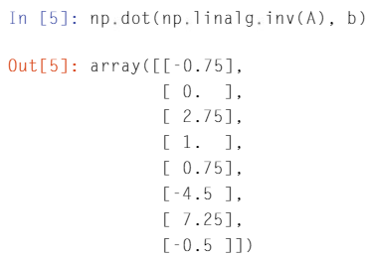
Example in Python (cont.)
The two cubic polynomials
S₁(x) = -0.75x³ + 2.75x + 1 for 0 <= x <= 1 and
S₂(x) = 0.75x³ – 4.5x² + 7.25x – 0.5 for 1 <= x <= 2
For x=1.5, we evaluate S₂(1.5) whose estimated value is 2.7813.

Slide 12


Lagrange Polynomial Interpolation
Finds a single polynomial that goes through all the data points, which is referred to as a Lagrange polynomial, L(x).
When computing Lagrange polynomials, it is useful to write them as a linear combination of Lagrange basis polynomials.
Lagrange basis polynomial
Lagrange polynomial
P_{i}(x_{j}) = 1 when i = j
P_{i}(x_{j}) = 0 when i ≠ j
L(x_{i}) = y_{i} for every point as described above

Slide 13
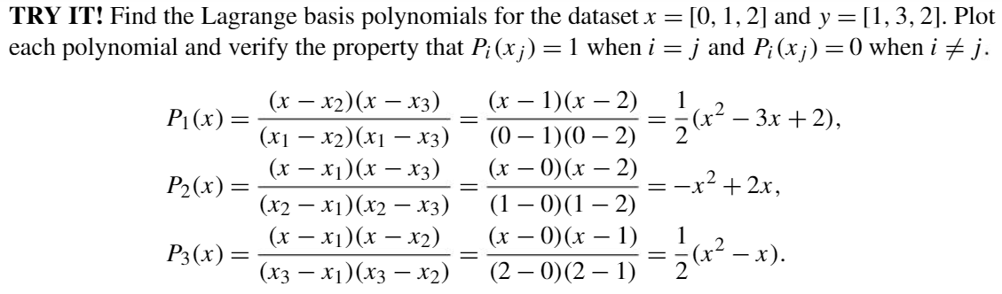
Lagrange Polynomial Interpolation in Python

Slide 14
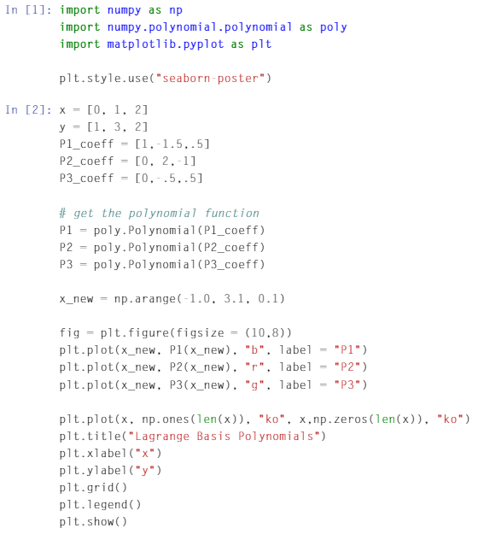
Lagrange Polynomial Interpolation in Python (cont.)

Slide 15
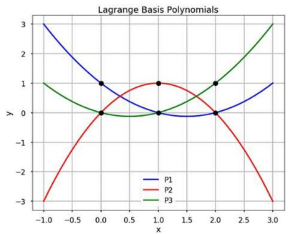
Lagrange Polynomial Interpolation in Python (cont.)

Slide 16
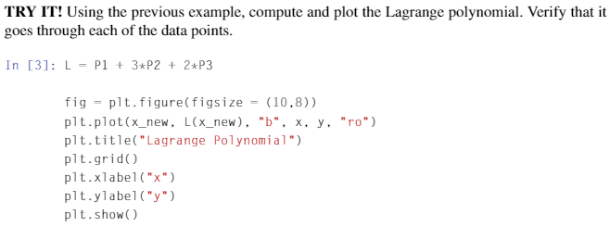
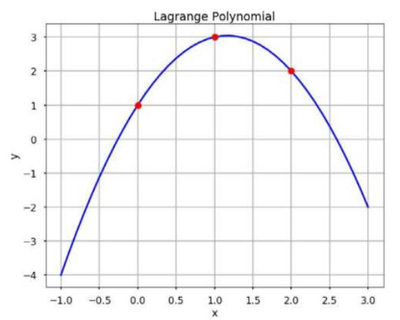
Lagrange Polynomial Interpolation in Python (cont.)

Slide 17
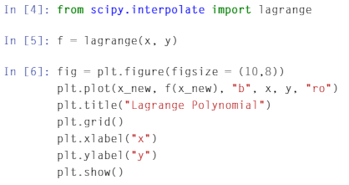
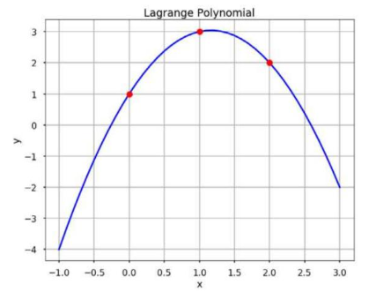
Lagrange Polynomial Interpolation in Python using Lagrange Function from Scipy

Slide 18



Newton’s Polynomial Interpolation
Another popular way to exactly fit a set of data points.
General form of the (n-1)th order Newton’s polynomial that goes through n points
which can be re-written as
where
Since the polynomial goes through each data point (x_{i}, y_{i}), we have f(x_{i}) = y_{i} → f(x₀) = a₀ = y₀ and f(x₁) = a₀ + a₁(x₁-x₀) = y₁.
We rearrange the equation to obtain a₁ →

Slide 19


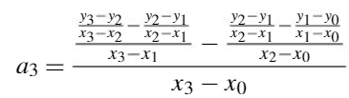



Newton’s Polynomial Interpolation (cont.)
Keep going to obtain all the coefficients.
See the pattern? These are called divided differences. If we define , then
If we continue, we obtain the following iteration equations:
1

Slide 20
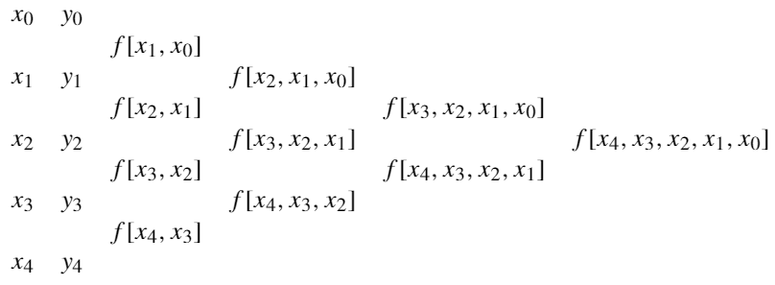
Newton’s Polynomial Interpolation (cont.)
Advantage
Once the coefficients are determined, adding new data points will not change the previously calculated coefficient.
The following presents a divided difference table for finding the higher differences.

Slide 21
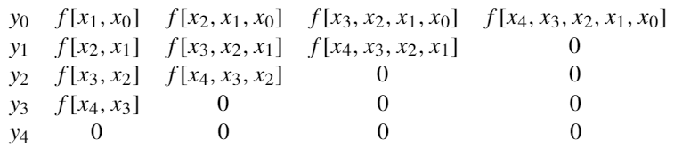
Newton’s Polynomial Interpolation (cont.)
From the divided difference table in the previous slide, we can calculate all coefficients and store them in a diagonal matrix.
The first row in the matrix is all the coefficients that we need.

Slide 22
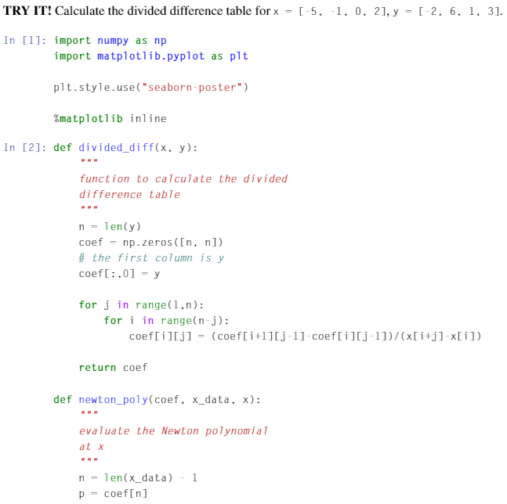
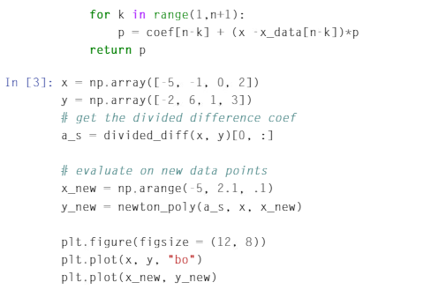
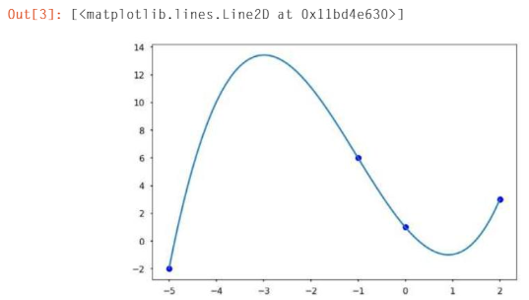
Newton’s Polynomial Interpolation in Python

